Slide 1
High Level Thoughts

Slide 2

Inspire

Slide 3
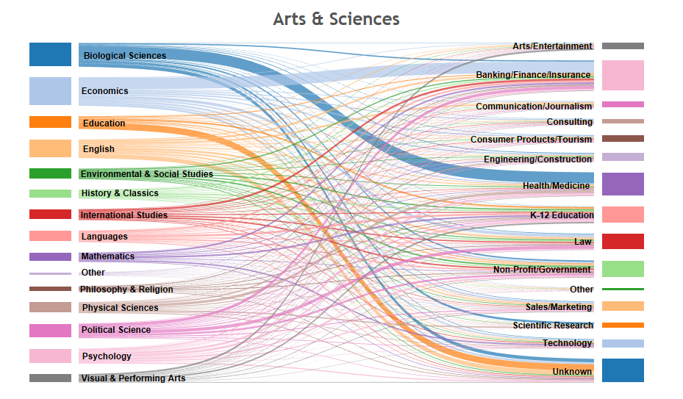
Career Path Awareness

Slide 4
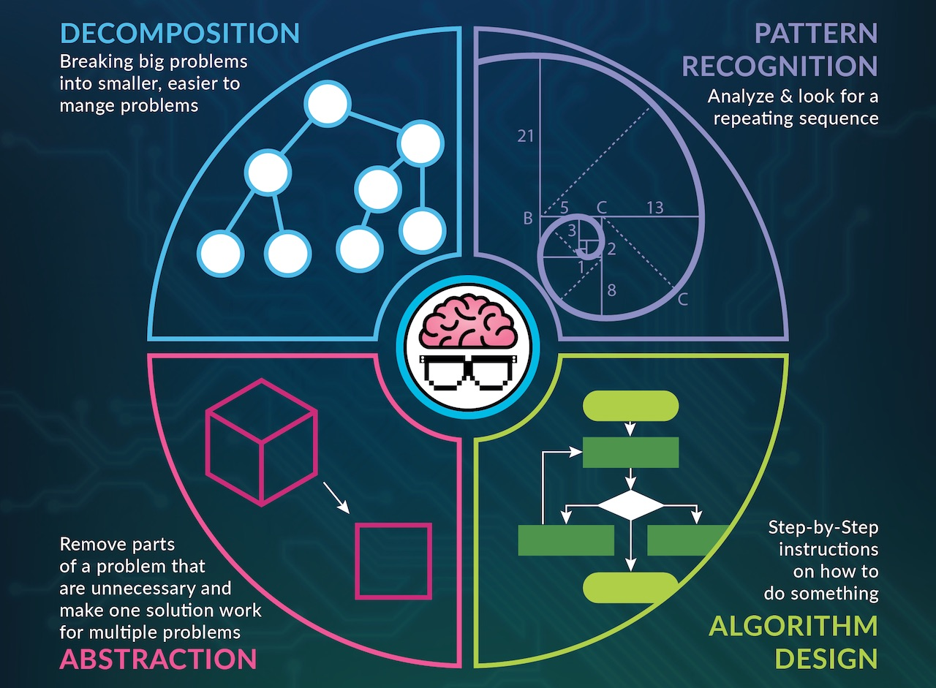
We use the wrong language

Slide 5
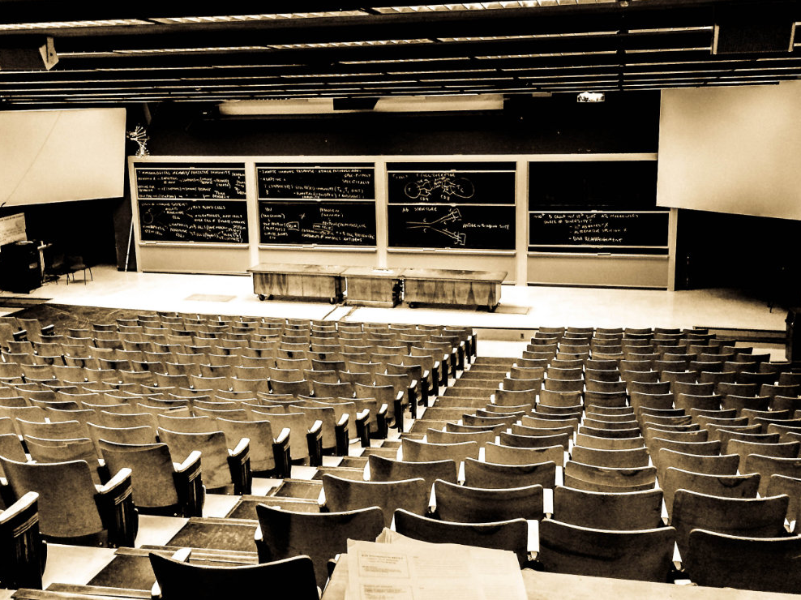
We are targeting the 5%

Slide 6

The identity thing …

Slide 7
Beautiful Patterns
The reason for the name …

Slide 8


Slide 9
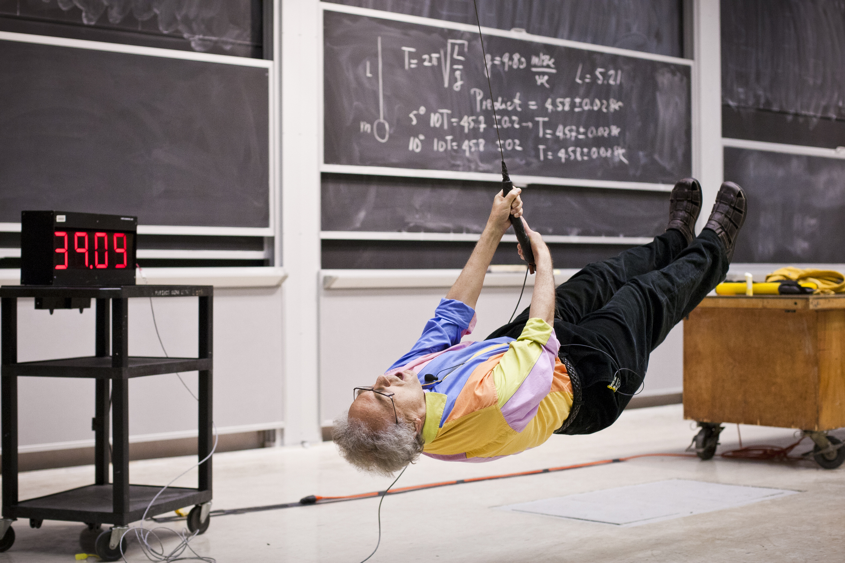
Passion

Slide 10

Share

Slide 11

Tell Stories

Slide 12

Your brain’s natural “save” button

Slide 13
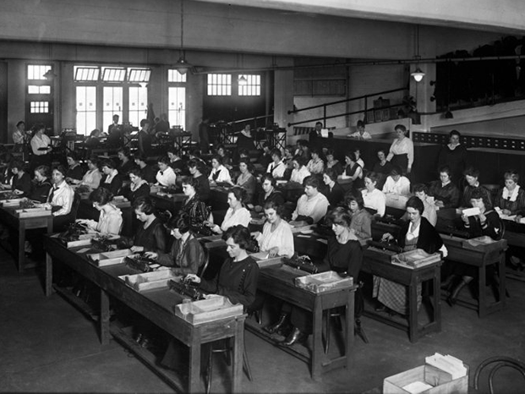
Kilo-girl-hours

Slide 14
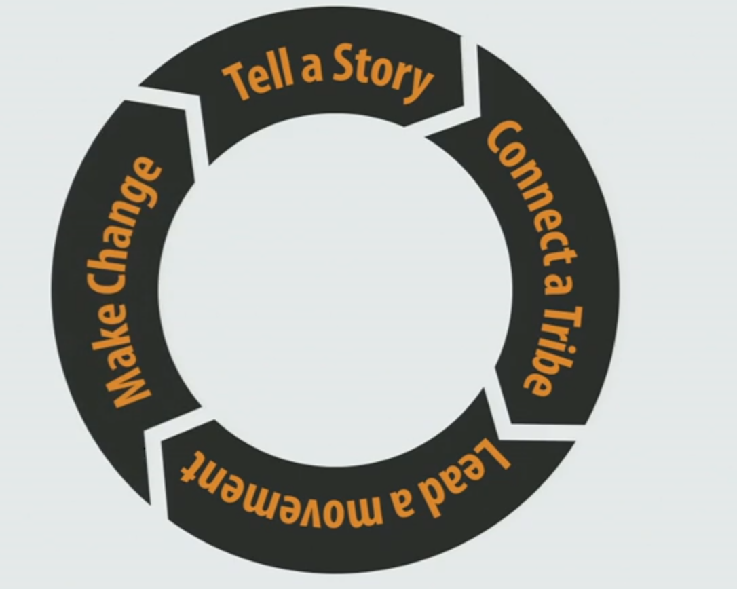
Seth Godin: The tribes we lead
http://www.ted.com/talks/seth_godin_on_the_tribes_we_lead

Slide 15
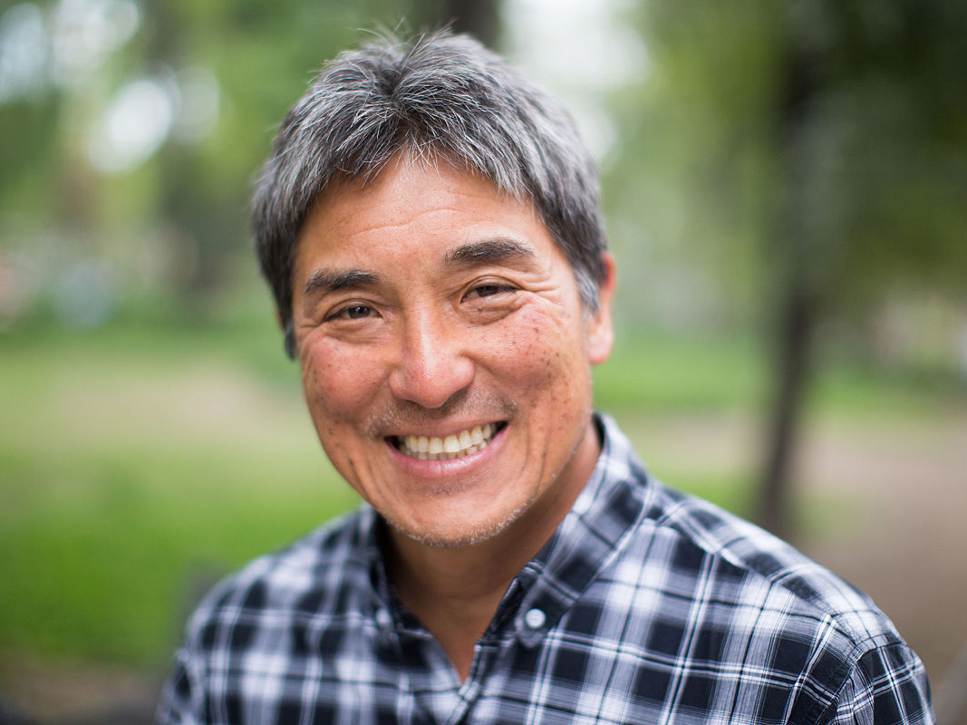
Kawasaki
10 slides
20 minutes
30 font

Slide 16
edX
6 minutes
Speak fast
No PowerPoint

Slide 17
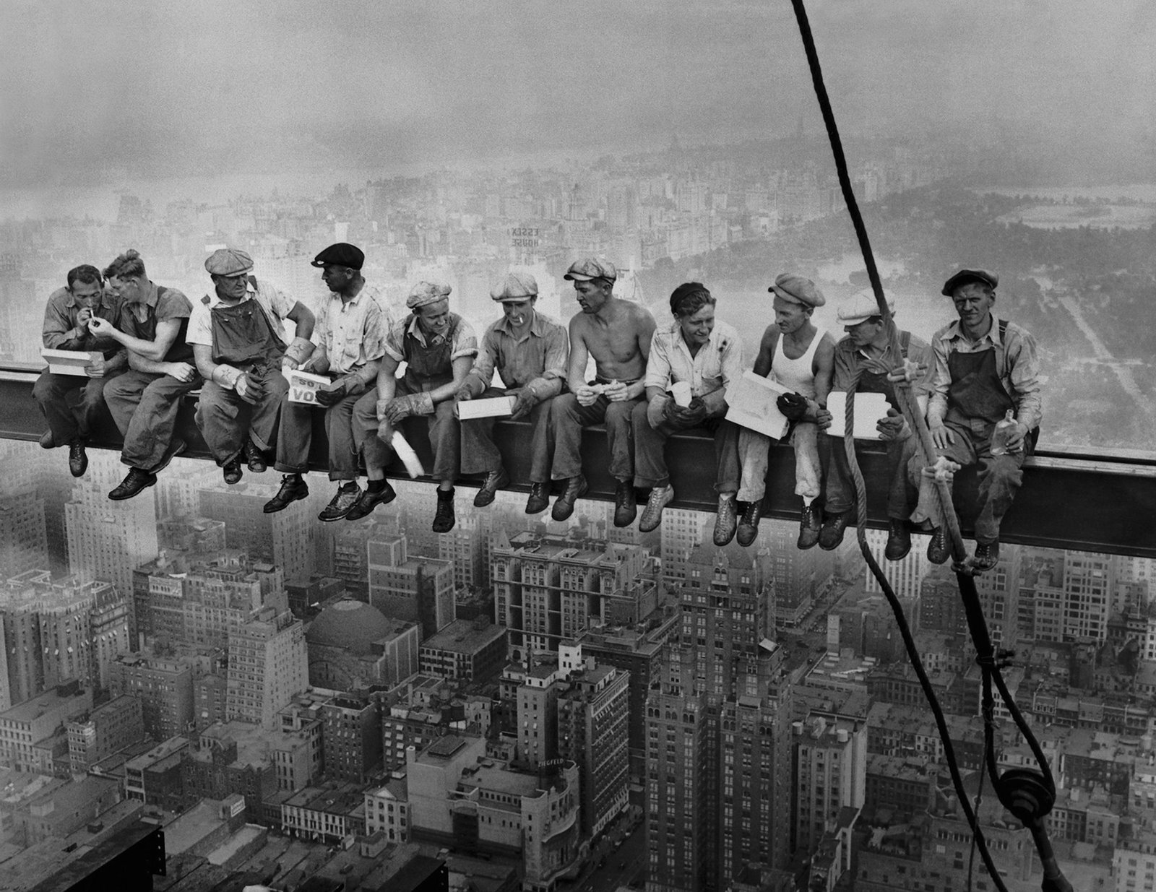
Images have higher recall

Slide 18
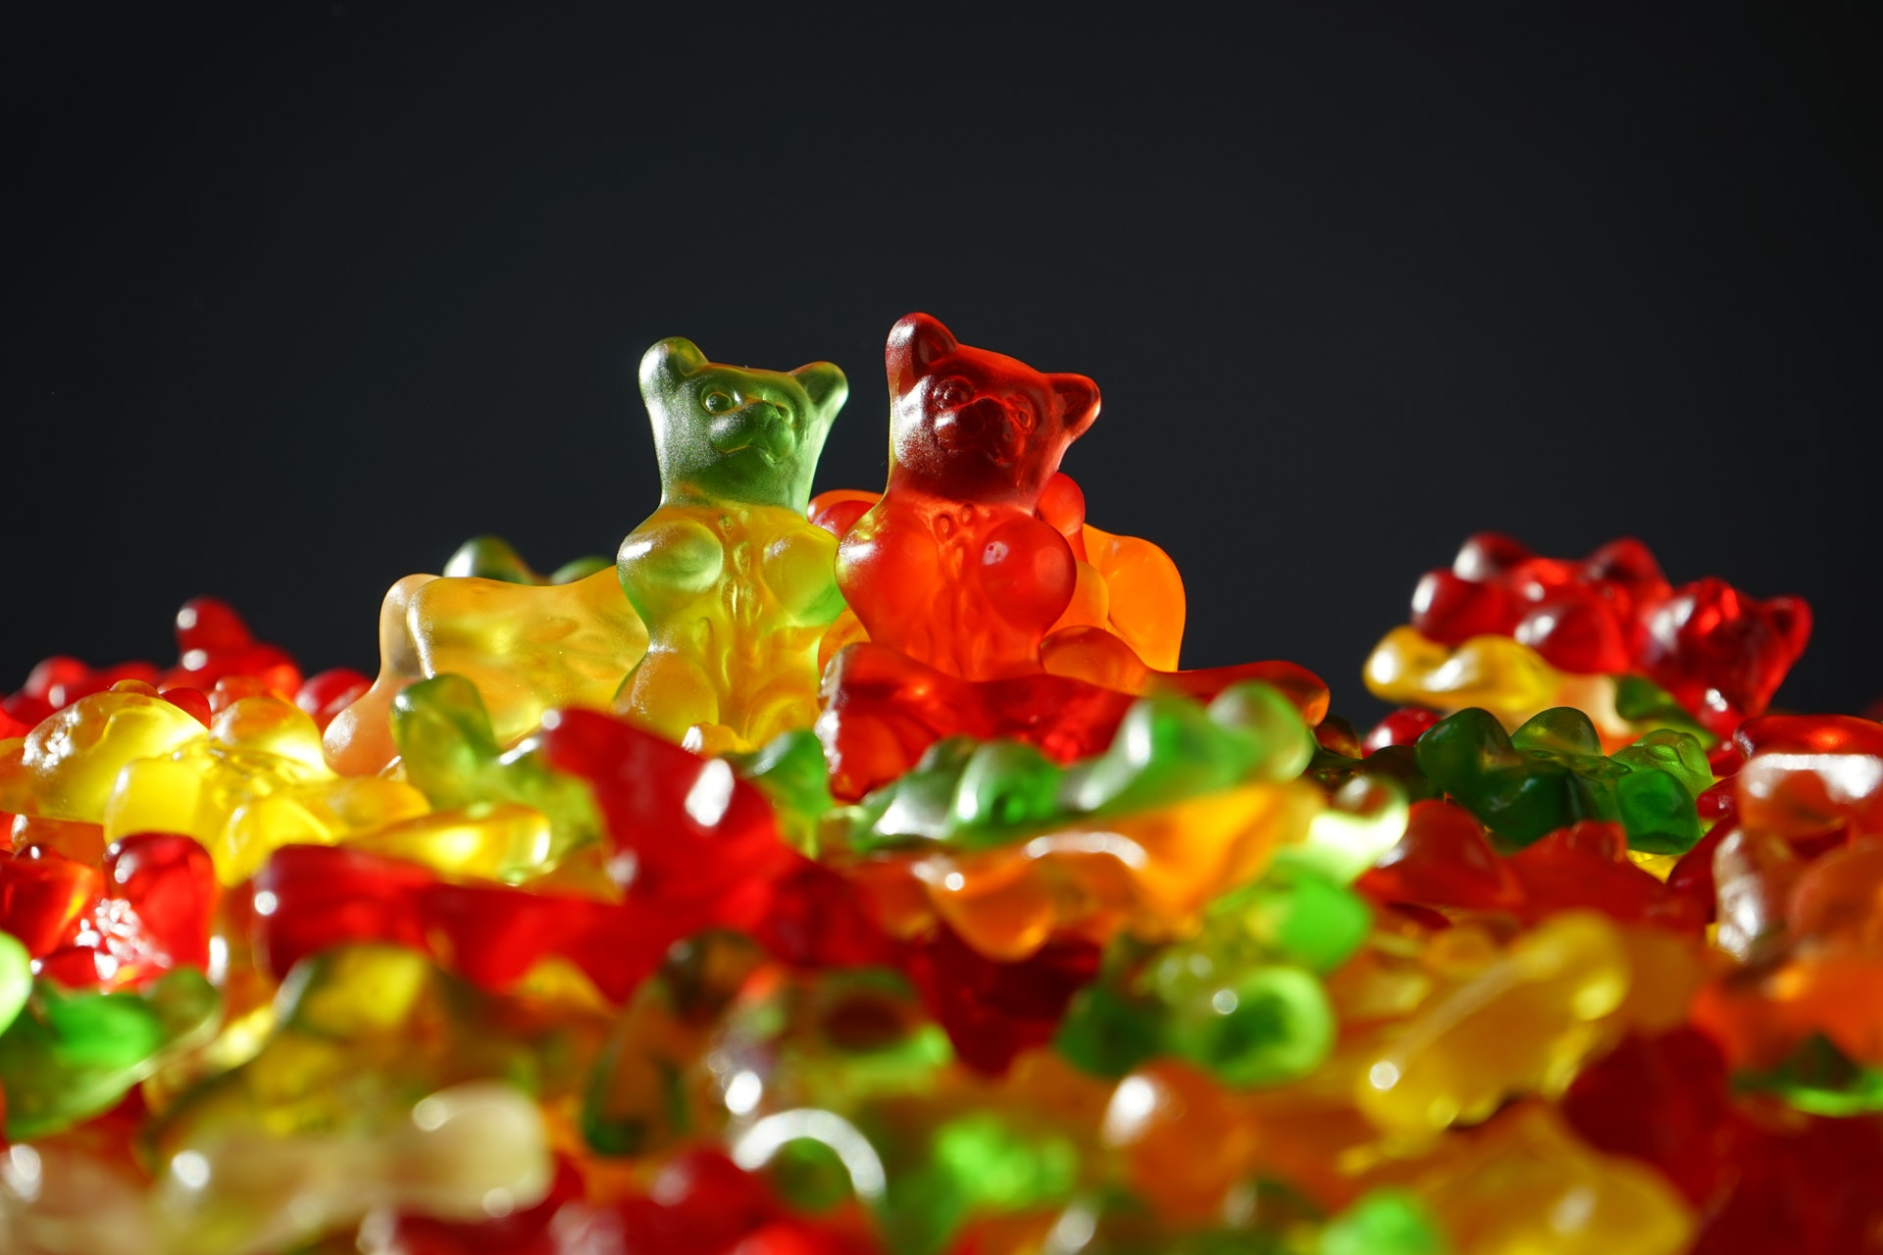
What works for you, will not work for others

Slide 19
Closing Thoughts
Passion is contagious
We are wired for stories
Your brain’s natural “save” button
Pictures are superior.
10-20-30
edX
Consider videos

Slide 20


